Slide 1
Introduction to
Science Literacy

Slide 2
Type/Write responses to these three questions...
What is literacy?
What is scientific literacy?
Why is scientific literacy important?

Slide 3
What does it mean to be literate?

Slide 4
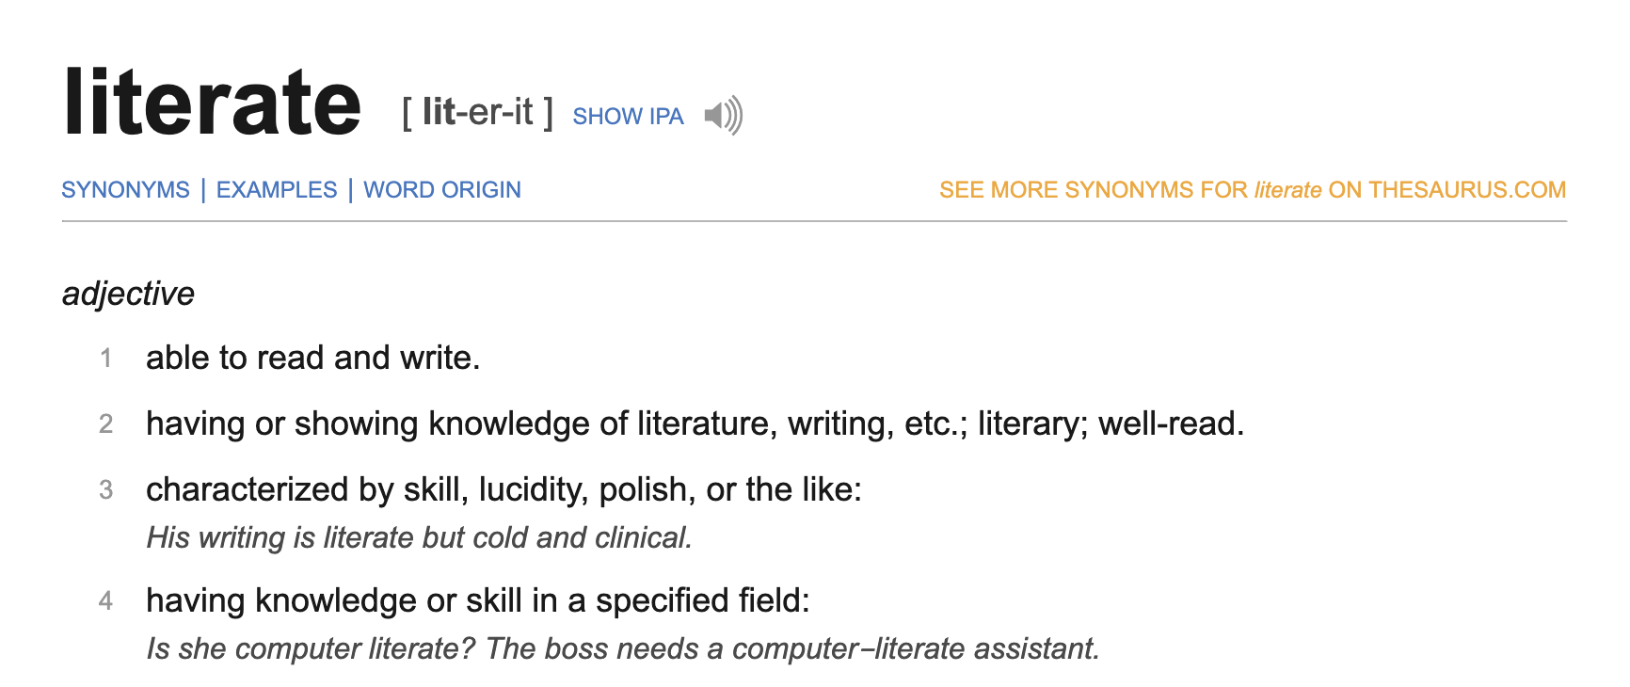
https://www.dictionary.com/browse/literate

Slide 5
What is scientific literacy?

Slide 6
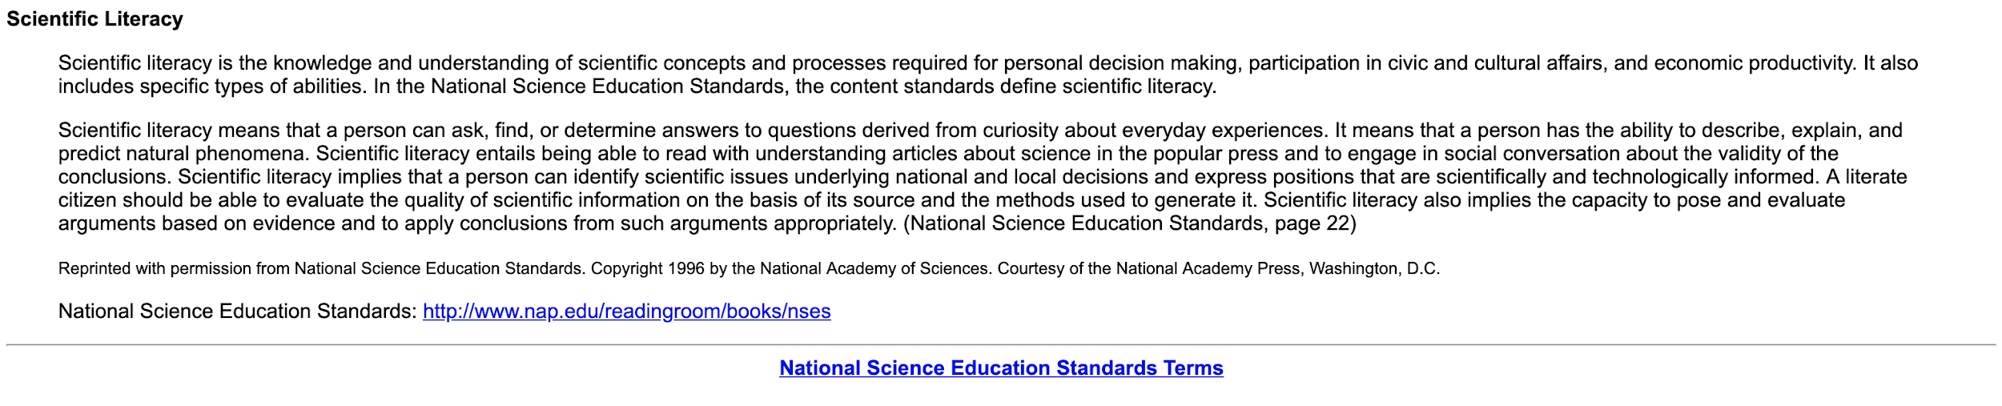
http://www.literacynet.org/science/scientificliteracy.html

Slide 7
Why is scientific literacy important?

Slide 8
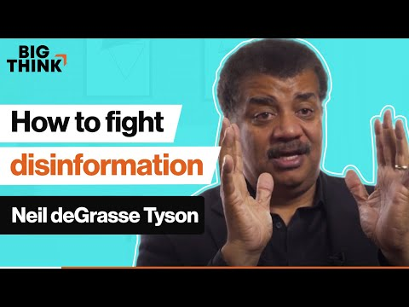

Slide 9


